Slide 1
Unit : 2
The Reference Model for Network Communication
Prepared By:
Mr. A. K. Panchasara
Computer Engineering Department, AVPTI, RAJKOT

Slide 2
Course Outcome
After completion of this unit, students will be able to…
Differentiate OSI and TCP/IP Models

Slide 3
Learning outcome
After completion of this session, students will be able to list all layers of OSI and TCP/IP model.

Slide 4
2.1 OSI Model
OSI is an Open System Interconnection model. The OSI model is developed by ISO.
An open system is a set of protocols that allows any two different systems to communicate regardless of their underlying architecture.
The purpose of the OSI model is to show how to facilitate communication between different systems without requiring changes to the logic of the underlying hardware and software.
The OSI model is NOT a protocol.
It is a model for understanding and designing a network architecture that is flexible, robust, and interoperable.
The OSI model has seven different separated layers each of which defines a part of the process of moving information across a network.
Notes:
OSI full model from Net, F, Technical, Atul etc.

Slide 5
Each layer uses the services provided by below layer and provide an interface to the upper layer.
Physical, Data link, Network, Transport, Session, Presentation and Application are the main seven layers of OSI model.
The seven layers can be thought of as belonging to three subgroups.
Layers I, 2, and 3-physical, data link, and network - are the network support layers.
Layers 5, 6, and 7-session, presentation, and application – are the user support layers.
Transport layer links the both of above network support and user support layers.

Slide 6
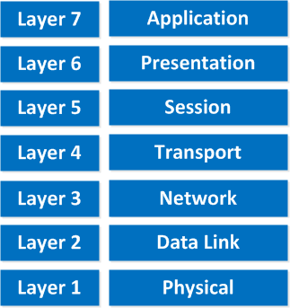
OSI reference model

Slide 7
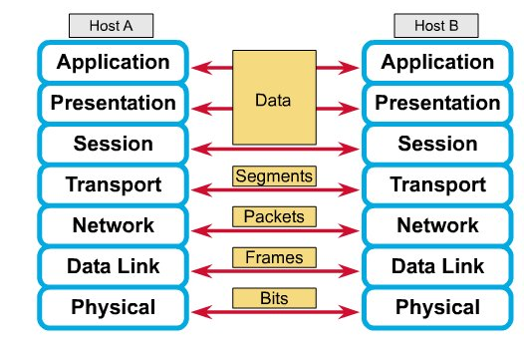
OSI reference model with host to host communication
Notes:
Frm Net

Slide 8
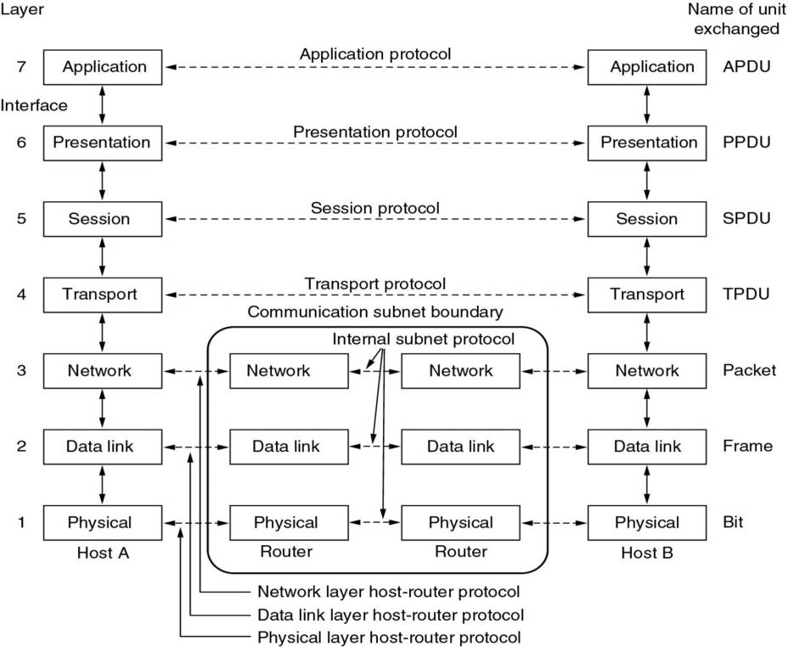
OSI reference model

Slide 10
Learning outcome
After completion of this session, students will be able to Describe functions of each layer of OSI reference model.

Slide 11
Following are the functions of each layer
Physical Layer
The layer is responsible for movement of individual bits from one hop (node) to next hop.
It is the lowest layer or first layer of the OSI model.
It is concerned with the transmission of raw bits over a communication channel.
At receiver side, It accept incoming stream of data and passes to the upper layer and also accept frames from upper layer (data link) and converts into bits.
Data unit at this layer is → ‘bit’.

Slide 12
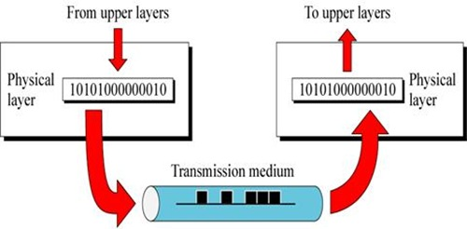
Physical Layer

Slide 13
Functions of Physical layer
It carries signals to higher layers
It defines the physical topology of a network.
It defines the direction of transmission between two devises: Simplex, Half duplex and Full duplex.
It encodes the bit streams into electric signals.
Hardware used at this layer are: hub, NIC, modem etc.
Protocols and standards of this layer are:
IEEE 802.5 (token ring)
IEEE 802.3 (Ethernet)
IEEE 802.11 (Wi-Fi)

Slide 14
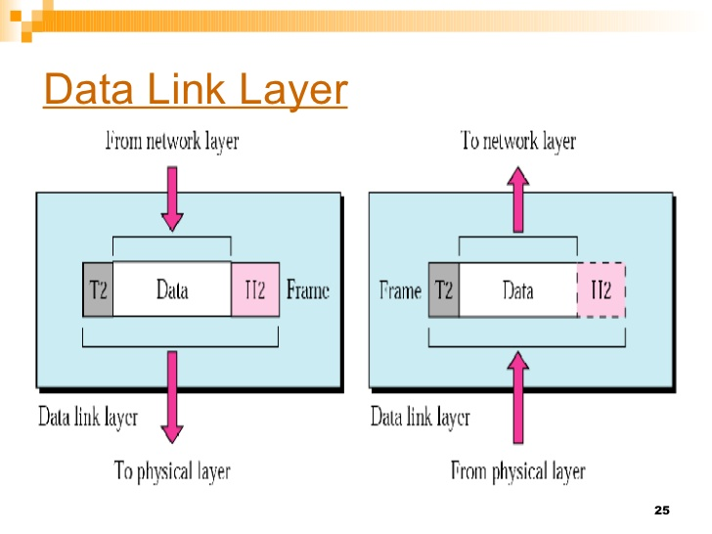
Data Link Layer
The layer is responsible for moving frames from one hop (node) to next hop.
It is the second layer of the OSI model in which raw bits are grouped into frames.
It makes the physical layer appear error free to upper layer (network).
It uses CRC (Cyclic Redundancy Check) to detect errors.
Data unit at this layer is → ‘frame’.

Slide 15
Functions of Data Link layer
Framing: converts packets received from network layers into frames and also converts bits from physical layer into frames.
Flow control: it provides data flow control when sender and receiver have different data rates.
Physical addressing: when frames are sent to different LANs, this layer adds sender and receiver address into header.
Error control: it provides facility of error control to retransmit the damaged and lost frames.
Access control: provide access control when multiple devices are connected to same link
Data link layer has two sub layers
Logical Link Control (LLC) → it deals with protocols, flow control and error control.
Media Access Control (MAC) → it deals with the control of medium.

Slide 16
Hardware used at this layers are: switch, gateway, firewall, proxy servers etc.
Protocols and standards of this layer are:
PPP (Point to point protocol)
PPTP (Point to point tunneling protocol)
L2TP (Layer2 Tunneling Protocol)
SLIP (Serial Line Internet Protocol) etc.

Slide 17
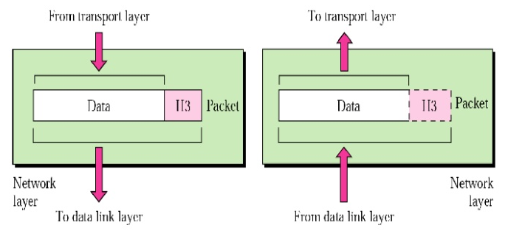
Network Layer
It is responsible for the delivery of packets from source host to destination host.
The network layer is responsible for the source-to-destination delivery of a packet across multiple networks (links). Whereas the data link layer oversees the delivery of the packet (frame) between two systems on the same network (links).

Slide 18
Functions of Network layer
Logical addressing: this layer adds a header into the packet includes logical address of sender and receiver.
Routing: this layer route the packets to its final destination in internetwork.
It provides quality of service management.
It provides security, load balancing and link management.
It provides connection oriented and connection less services to its upper layer (transport).
Hardware used at this layer are: router, layer3 switch, firewall, proxy server, gateway etc.
Protocols and standards of this layer are: ICMP, ARP, RARP, IPSec, IPv4/IPv6.

Slide 19
Transport Layer
The transport layer is responsible for the delivery of a message from one process to another.
It is responsible for source to destination delivery of a entire message, while network layer is responsible for source to destination delivery of individual packets.
Network layer doesn’t recognize any relationship between packets, while in case of transport layer, it ensures that whole message arrives in order and it also checks error control and flow control.
The data unit at this layer is → ‘segment’.

Slide 20
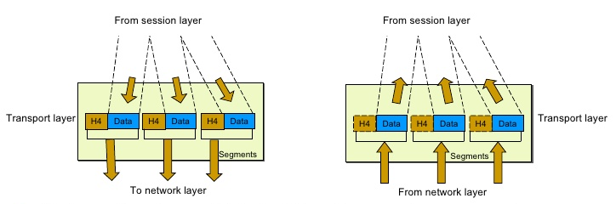
Transport Layer

Slide 21
Functions of Transport layer
Segmentation and reassembly: a message divided into segments, each segment contains a sequence number which enables transport layer to reassemble at destination.
Synchronization of data: this layer ensures that data must be received in the sequence in which it was sent.
This layer provides error correction of data and ensures error free transmission.
Flow control: this layer performs end-to-end flow control while data link layer do it across the link.
Connection control: this layer performs connection less or connection oriented with the destination machine.
Hardware used at this layer are: gateway, proxy server, content filtering firewall, etc.
Protocols and standards of this layer are: TCP (Transmission Control Protocol) and UDP (User Datagram Protocol).

Slide 22
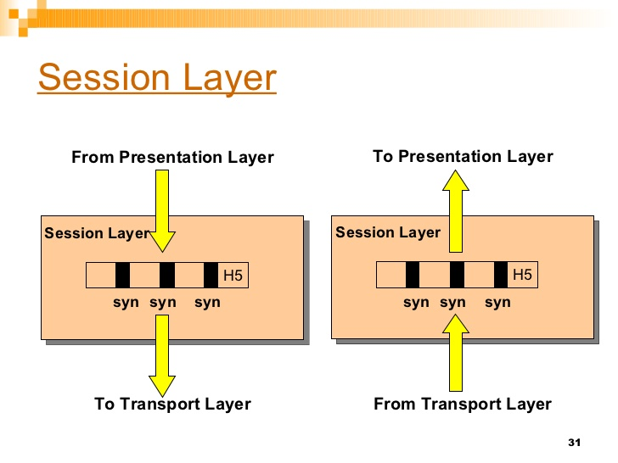
Session Layer
The session layer is responsible for dialog control and synchronization.
It is responsible for establishing, maintaining and terminating the connection between two communicating devices.
It also provides dialog control between devices.
It offers different communication modes like: simplex, half duplex and full duplex.
The data unit at this layer is → ‘data’.

Slide 23
Functions of Session layer
Dialog control: the session layer manages dialog control while communication take place.
Synchronization: this layer adds synchronization points (check points) into streams of data.
Hardware used at this layer are: gateway, proxy server, content filtering firewall, etc.
Protocols and standards of this layer are: SIP (Session Initiation Protocol) and RTP (Real time Transport Protocol).

Slide 24
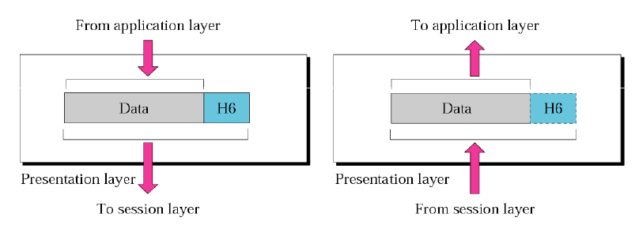
Presentation Layer
The presentation layer is responsible for translation, compression, and encryption.
The presentation layer is concerned with the syntax (format of data) and semantics (meaning of each section of bits) of the information exchanged between two systems.
This layer structures the data passed down from the application layer into a format suitable for network layer.
The data unit at this layer is → ‘data’.

Slide 25
Functions of Presentation layer
Translation: this layer maintains interoperability between two encoding systems.
Encryption and decryption: for security purpose, this layer transforms sender information into non readable form while sending data. Also doing decryption (reverse process of encryption).
Data compression: reducing number of bits required to represent data.
Hardware used at this layer are: gateway, application switch, proxy server, content filtering firewall, etc.
Protocols and standards of this layer are: SSL (Secure Socket Layer), MIME (Multipurpose Internet Mail Extension), TLS (Transport Layer Security) etc.

Slide 26
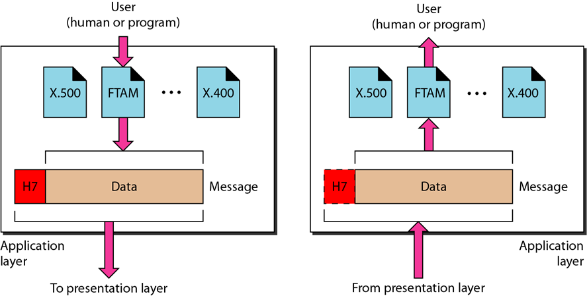
Application Layer
The application layer is responsible for providing services to the user.
It is the final and highest layer of the OSI model
This layer allows access for network resources to users.
It provides user interface and supports services like E-mail, remote file access, database management and other distributed information services.
This layer taking care of availability of resources.
The data unit at this layer is → ‘data’.

Slide 27
Functions of Application layer
Network Virtual Terminal: allows a user to log on to a remote host.
Mail services: provides services like email storage and forwarding.
Directory services: access of global information and distributed database.
Hardware used at this layer are: gateway, application switch, proxy server, content filtering firewall, etc.
Protocols and standards of this layer are: HTTP, FTP, DNS, SMTP, POP3, SNMP, TFTP, PING, DHCP etc.

Slide 28
Summary of Layer Functions

Slide 29
Comparison Physical, Logical and Port Addresses
Features (Criteria) | Physical Address (MAC Address) | Logical IPv4 Address | Port Address
Layer in OSI Model | Data Link Layer (Layer 2) | Network Layer (Layer 3) | Transport Layer (Layer 4)
Scope | Local network segment | Across networks and internet | Within device and network
Format | Hexadecimal separated by colons or hyphens | Decimal separated by periods | 16-bit unsigned integer
Uniqueness | Globally unique | Unique within a network | Unique within a device and network
Assignment | Hardcoded into hardware | Dynamically assigned | Not hardcoded, assigned dynamically
Purpose | Identifies network interface | Identifies device on a network | Identifies service or application
Examples | 00:1A:2B:3C:4D:5E | 192.168.1.1 | 80 (HTTP), 443 (HTTPS), etc.

Slide 30
Learning outcome
After completion of this session, students will be able to Compare OSI and TCP/IP model

Slide 31
2.2 TCP/IP Model (Internet Model)
TCP/IP stands for Transmission Control Protocol / Internet Protocol.
TCP/IP model was developed before to the OSI model.
Therefore, the layers in the TCP/IP protocol suite do not exactly match those in the OSI model.
This model consist of set of protocols that allow communication across multiple different networks.
There are mainly four layers in this model → Host-to-network layer (Link layer), Internet layer , Transport layer and Application layer.
The first two layers (physical and data link) of OSI model are represented as host-to-network (link) layer in TCP/IP model and last three layers (session, presentation, application) of OSI model are represented as application layer in TCP/IP model.
Notes:
TC-IP model frm Net, Technical, Atul, F etc

Slide 32
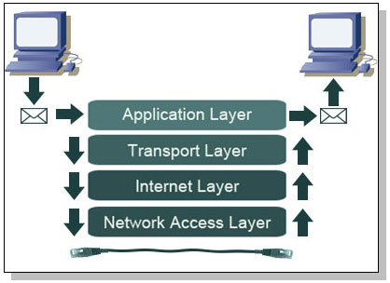
TCP / IP model
Notes:
Frm Net

Slide 33
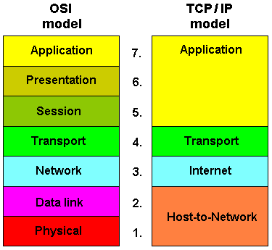
TCP / IP model (2)
Notes:
Frm Net

Slide 34
Following are the functions of each layer
Link layer (host-to-network) layer
It is also called ‘network interface layer’.
This layer provides mechanism of sending and receiving actual data.
This layer is independent of network architecture and hardware.
It controls hardware and media communication in the network.
Network layer (IP layer)
This layer defines the host addressing and routing.
It finds best path across networks.
IP (internet protocol) works on this layer. Including IP, this layer functioning with four supportive layers: ARP, RARP, ICMP and IGMP.
Packets in the IP layer called ‘datagram’.
The function of network layer is explained by following protocols

Slide 35
IP (Internetwork protocol)
It is connection less and unreliable protocol.
It doesn’t provide error checking and packet tracing.
ARP (Address Resolution Protocol)
ARP is used to find the physical address of the node when the logical address (IP address) is known.
RARP (Reverse Address Resolution Protocol)
It is used to find the logical address of the node when its physical address is known.
ICMP (Internet Control Message Protocol)
It is network diagnostic and error reporting protocol.
IGMP (Internet Group Message Protocol)
It is used provide facility for multicast transmission.

Slide 36
Transport layer
It supports communication of multiple devices across different networks.
It also defines how data should flow between different hosts.
This layer ensures data delivery between hosts is in order or not and also it is responsible for end-to-end delivery.
Major protocols of this layer are: TCP and UDP. Both these protocols are used for port-to-port communication.
TCP (Transmission Control Protocol)
It provides full transport layer services to application.
It is connection oriented and reliable protocol. Means a connection must be established between both ends before transmission.
The packet produced by TCP is called ‘segment’.

Slide 37
UDP (User Datagram Protocol)
It is simple, connection less and unreliable protocol.
The packet produced by UDP is called ‘datagram’.
Application Layer
It is the final and highest layer in TCP/IP model which is equal to the combined session, presentation and application layer of OSI model.
The functions of this model are explained by the following protocols.
SMTP (Simple Mail Transfer Protocol)
It is used to transfer electronic mail (E-mail) from one user to another.
HTTP (Hyper Text Transfer Protocol)
Is provides a standard for web users and servers to communicate.

Slide 38
FTP (File Transfer Protocol)
FTP is the most widely used protocol for file transfer over the network.
It is reliable and simple.
It uses TCP/IP for communication and it works on TCP port 21.
HTTP (Hyper Text Transfer Protocol)
Is provides a standard for web users and servers to communicate.
SNMP (Simple Network Management Protocol)
It provides a set of operations for monitoring and maintaining devices in the internet.
TELNET (Terminal Network)
It is a general purpose protocol used for remote login.
DNS (Domain Name Server)
It resolves an IP address into textual address for hosts connected over a network.

Slide 39
Learning outcome
After completion of this session, students will be able to differentiate between connection oriented and connectionless services/approach.

Slide 40
2.3 Connection oriented v/s Connection less services
Connection oriented services | Connection less services
- In connection oriented service we have to establish a connection before starting the communication. | - No need to establish a connection in prior.
- it is more reliable | - It is less reliable
- Authentication is needed in it. | - Authentication is not needed.
- After sending, this service checks the message is received or not. | - there is no guarantee of a delivery of message.
- It is slower. | - It is faster.
- It is implemented using circuit switching. | - It is implemented using packet switching.
- Error correction and flow control provided in it. | - Error correction and flow control not provided.
- Example is telephone system. | - Example is postal system.
- Protocol: TCP (transmission control protocol) | - Protocol: Example: UDP (User Datagram Protocol)
Notes:
From Net

Slide 41
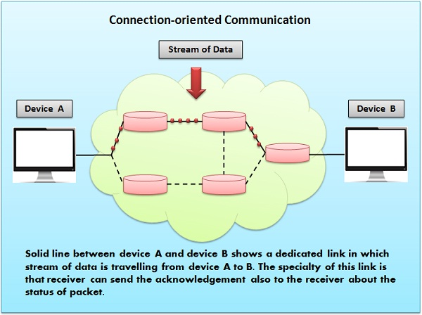
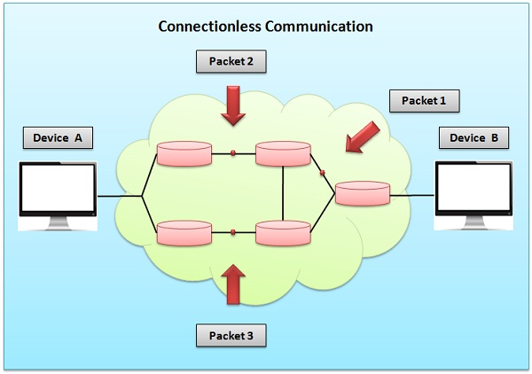

Slide 42
Learning outcome
After completion of this session, students will be able to compare OSI and TCP/IP model.

Slide 43
2.4 Comparison of OSI and TCP/IP models
OSI | TCP/IP
- Full form: Open System Interconnection. | - Full form: Transmission Control Protocol / Internet Protocol.
- It has seven layers. | - It has four/five layers.
- OSI model developed after TCP/IP model. | - It is developed before OSI model.
- In this model, transport layer guarantees the delivery of packets. | - In this model, transport layer does not guarantees delivery of packets.
- It follows vertical approach. | - It follows horizontal approach.
- OSI model has separate presentation layer and session layer. | - TCP/IP model does not have separate presentation and session layer.
- Network layer in this model provides both connection less and connection oriented service. | - Network layer in this model provides only connection less service.
- In it, services, interface and protocols are clearly separated. | - In it, services, interface and protocols are not clearly separated.
- It is just a reference model. | - It is the implementation of OSI model.
Notes:
Frm net

Slide 44
Thank You…

